Slide 1
Mastering System Design
From Basics to Cracking Interviews
Rahul Rajat Singh

Slide 2
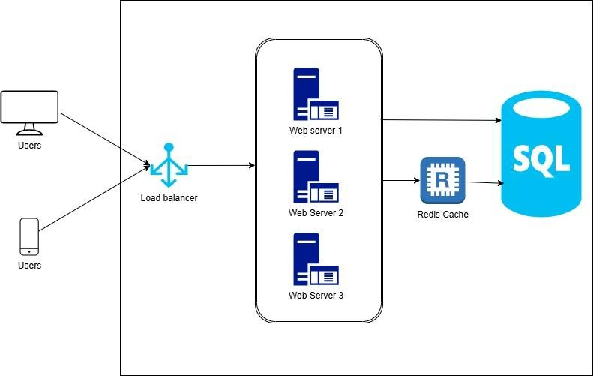
What is System Design?
System Design is the process of defining the architecture, components, modules, interfaces, and data flow for a system to meet specific requirements.
It involves making high-level
decisions about scalability, reliability, performance, and maintainability.
Used in real-world applications like
designing scalable web apps, distributed systems, databases, and cloud infrastructures.

Slide 3
Why is System Design Important?
Scalability & Reliability – Ensures systems handle millions of users without failure.
Architectural Thinking – Goes beyond coding; involves trade-offs like CAP theorem, SQL vs. NoSQL.
Career Growth – Essential for becoming a senior engineer or architect.
Real-World Problem Solving – Helps in building actual systems, not just clearing interviews.
Trade-Offs & Decision Making – Balances scalability, cost, speed, and complexity.
Future-Proofing – Prevents bottlenecks and allows smooth evolution of software.
Note: Many learners approach system design just to crack interviews, but in reality, understanding system design is a critical skill for building scalable, reliable, and efficient software systems. If you deeply understand system design principles, interviews will naturally become easier—but more importantly, you'll be able to architect real-world solutions effectively.

Slide 4
The Evolution of System Design Over the Last 25 Years
1995-2005: Early Monolithic Web Applications
LAMP stack (Linux, Apache, MySQL, PHP) dominated
Stateless servers, single-node databases, basic MVC architectures
Server-side rendering, no real-time features
2005-2010: Scaling Challenges & Distributed Systems
Social media & e-commerce drove demand for better performance
Introduction of caching (Memcached, Redis), CDNs, and database replication
Horizontal scaling & load balancing became standard
2010-2015: The Cloud Revolution
AWS, Azure, GCP enabled on-demand infrastructure scalability
Shift to virtualized & containerized deployments
NoSQL databases (MongoDB, Cassandra) gained popularity
2015-2020: Microservices & Event-Driven Architectures
Monoliths evolved into microservices for agility
API gateways, service meshes, event-driven systems (Kafka, RabbitMQ)
CI/CD pipelines streamlined software delivery
2020-Present: Real-Time, AI-Driven & Edge Computing
Focus on low-latency (streaming, AI-driven recommendations)
Serverless computing, Kubernetes, and edge computing growth
Increased emphasis on security, compliance, and observability

Slide 5
How This Course is Structured?
Introduction – Overview of system design and its real-world importance
System Design Fundamentals – Core concepts, architecture patterns, and trade-offs
Scalability – Handling growing traffic, load balancing, caching, and database sharding
Storage – SQL vs. NoSQL, distributed databases, and data partitioning strategies
Performance – Optimizing latency, throughput, and efficiency
Reliability – Ensuring fault tolerance, high availability, and disaster recovery
Security – Authentication, authorization, and data protection best practices
Putting It All Together – Combining principles to design real-world systems
Approach for System Design – Frameworks and methodologies for structuring solutions
Case Studies – Deep dives into real-world architectures of companies like Netflix, WhatsApp, and Uber
Interview Tips – Strategies to excel in system design interviews
Note: Each section consists of multiple lessons, covering concepts in depth.

Slide 6
How to Navigate This Course Effectively
Start with Fundamentals — build depth & clarity
Case Studies — simulate real interview discussions
Use the 4-Step Design Framework to stay structured
Don’t skip details — pause, research, resume
Topics are interconnected — revisit the course once again

